Slide 1

Informatics & Computer Sciences
Module Title:
Introduction to Programming and Problem Solving
Module Aim:
Accessing Files in the computer system.
The different user defined complex type of data: structures, arrays, classes.
Pointers and linked lists

Slide 2
Introduction to Programming and Problem Solving
Module Title:
Introduction to Programming and Problem Solving
Module Regulation:
This module is not condonable, means that students pass the module only if the mark is greater than 40.
The pass of this module is a must to progress to next year.
Module Code:
20CSCI02P
Assessment:
In-Lab test 1 carries [15%] of the total mark and aims to develop and assess learning outcomes 1 - 3. It covers lectures 1, 2 and 3 in Week 7.
In-Lab test 2 carries [15%] of the total mark and aims to develop and assess learning outcomes 4 - 6. It covers lectures 4, 5 and 6 in Week 12.
One In-class quiz of [10%] in Week 6 and 10 quizzes in in All Weeks [best 5 quizzes are considered] of 10%
Final examination carries 50% of the total mark and assesses learning outcomes 1 - 6.
Text Book:
Tony Gaddis, "Starting Out with C++: From control structures through objects", 7th Edition, Pearson, 2012.
Nell Dale, Charles C. Weems, "Programming and Problem Solving with C++, 4th Edition", Jones and Bartlett Publishers, Sudbury, MA, 2004, 1100 pp.
2

Slide 3
Introduction to Programming and Problem Solving
Weekly Plan:
Week | Lecture | Lab | Assessment
1 | Functions (1) | ---
2 | Functions (2) | Function (1) | Quiz 1 [2%]
3 | Files (1) | Function (2) | Quiz 2 [2%]
4 | Files (2) | Files (1) | Quiz 3 [2%]
5 | 1D arrays (1) | Files (2) | Quiz 4 [2%]
6 | 1D arrays (2) | 1D arrays (1) | Quiz 5 [2%] & In class Quiz [10%]
7 | 2D arrays | 1D arrays (2) | Quiz 6 [2%] & In lab test (1) [15%]
8 | Pointers | 2D arrays | Quiz 7 [2%]
9 | Pointers | Pointers | Quiz 8 [2%]
10 | Problem Solving | Pointers | Quiz 9 [2%]
11 | Problem Solving | Revision | Quiz 10 [2%]
12 |  | --- | In lab test (2) [15%]
3

Slide 4
Introduction to Programming and Problem Solving
Teaching Scedule
 | Saturday | Sunday | Monday |  | Tuesday | Wednesday |  | Thursday
Slot 1
9:00 |  |  | Intro. to Prog. & Problem Solving | H-Lab | H-Lab | H-Lab |  | H-Lab | H-Lab
9:50 |  |  |  | Intro to Prog. | Intro to Prog. | Intro to Prog. |  | Intro to Prog. | Intro to Prog.
 |  |  | Dr. Mostafa Salama | TA. | TA. | TA. |  | TA. | TA.
Slot 2 |  |  | Lecture | TA. | TA. | TA. |  | TA. | TA.
10:00 |  |  | G-LH 6 | Group 9 | Group 3 | Group 8 |  | Group 5 | Group 6
10:50 |  |  | G1 - G6
Slot 3 |  |  |  |  |  |  | 22CSCI02P
11:00 |  |  | H-Lab | H-Lab | H-Lab | H-Lab | Intro. to Prog. & Problem Solving | H-Lab | H-Lab
11:50 |  |  | Intro to Prog. | Intro to Prog. | Intro to Prog. | Intro to Prog. |  | Intro to Prog. | Intro to Prog.
 |  |  | TA. | TA. | TA. | TA. | Dr. Mostafa Salama | TA. | TA.
Slot 4 |  |  | TA. | TA. | TA. | TA. | Tutorial | TA. | TA.
12:00 |  |  | Group 1 | Group 10 | Group 7 | Group 4 | G- LH 5 | Group 11 | Group 12
12:50 |  |  |  |  |  |  | (joint G7 to G12)
Slot 5 |  |  |  |  |  | 22CSCI02P
13:00 |  |  | Intro. to Prog. & Problem Solving |  | H-Lab | Intro. to Prog. & Problem Solving
13:50 |  |  |  |  | Intro to Prog.
 |  |  | Dr. Mostafa Salama |  | TA. | Dr. Mostafa Salama
Slot 6 |  |  | Lecture |  | TA. | Tutorial
14:00 |  |  | A-LH 2 |  | Group 2 | G- LH 2
14:50 |  |  | G7 - G12 |  |  | (joint G1 to G6)
Slot 7
15:00
15:50

Slide 5
Introduction to Programming and Problem Solving
Contact List:
Module Leader :"Mostafa Salama" mostafa.salama@bue.edu.eg
Senior Teaching Assistant: "Basma.Hathout" Basma.Hathout@bue.edu.eg
Senior Teaching Assistant: "Lobna.Hesham" Lobna.Hesham@bue.edu.eg
Teaching Assistant: "aya.Hesham" ayah.hesham@bue.edu.eg
Teaching Assistant: “Dina Zekry" dina.zekry@bue.edu.eg
Teaching Assistant: “Dina Zekry" dina.zekry@bue.edu.eg
Teaching Assistant: “Cherine Mohamed” cherine.mohamed@bue.edu.eg
Teaching Assistant: “ Ismail.Hamdy ismail.hamdy@bue.edu.eg
5

Slide 6
So far learned in C++
Data Types
char
int
bool
Complex
Data Types
Primitive
Data Types
double
String
float
Libraries
cmath
iostream
Functions
Conditional statements
if
Control Statements
switch
Loops
for
while

Slide 7
So far learned in C++
int x;
This line is a variable definition, x is of a simple data type int. A place in the memory is reserved for the integer x. The data type of this variable is integer, which means that this place in the memory is prepared to save integers only.
string str = "BUE"; //string is a class, and str is object of this class.
str.at(1); //function at() in the class string is applied on text "BUE".
The datatype of the object str is the class “string” in the string library. A class is a complex datatype that does not contains data only, but contains functions also. The class string contains a data text and contains functions to operate on the data, like substr(), at(), and find(). Any object of type class string contains a text and the same functions in the class string.
Characters, integer, double, float and bool variables holds only one data value, that is why called simple. While objects holds various data values like string, it contains various characters, that is why called complex.

Slide 8
Introduction to Computing
Lecture 1
functions
Dr. Mostafa Salama

Slide 9

Program 1 : Functions in C++
//Any C++ program must contain a main function.
//This program contains also another function named "dispMsg".
#include <iostream>
using namespace std;
// Function definition - display Message
void dispMsg() //This is a function header.
{
cout << "Hello from the function dispMsg.\n";
}
// Function main()
int main() //This is the main function header.
{
cout << "Hello from the main function.\n";
dispMsg(); //This is a function call.
cout << "Back again to the main function.\n";
return 0;
}
Start
main()
Print
“Hello main”
Call function
dispMsg()
Start
dispMsg()
Here,main() function is waiting until dispMesg() function ends
Print
“Hello dispMsg”
end
dispMsg()
Print
“Back main”
end
main()

Slide 10
Program 1 : Functions in C++
// Function main()
int main() //This is the main function definition.
{
..
return 0;
}
A function is a collection of statements that performs a specific task.
Any program in C++ must contain a main function. The processing of the program starts at the start of the main function “{”, and the processing of the program ends at the end of the main function “}”.
A program may contain more functions in addition to the main function.
Any function in C++ has 4 important parts:
Function Name : “main”
Function body : between the two curly brackets “{” and “}”.
Function input parameters : between two circular brackets “(” and “)”.
Function output: the data type of the returned value from the function.
Name
Input parameters
Output
Type
void main ( )
{
cout << "Hello World!";
}
Function
Body

Slide 11
Program 1 : Functions in C++
// Function main()
int main() //This is the main function header.
{
..
return 0;
}
The definition of any function contains the output, the name and the input of the function.
The function main is the soul of the program, the header of the main function in line 11 must be in the form (int main()).
The return type of the main function is an integer which is abbreviated by the word int. Accordingly, the body of the main function must end by a return statement. Usually, the returned value by function main is the integer value 0.
The name of the main function is (main) with small case of all the letters. The word main is a reserved word in C++ and the programmer can not use any other name to refer to the main function.
The main function has no input parameter, the programmer must keep the brackets () of the main function empty.
The body of the main function between {} contains the statements of the program, the last statement of main function must be return 0; that ends the function.

Slide 12
Program 1 : Functions in C++
// Function definition - display Message
void dispMsg() //This is a function header.
{
cout << "Hello from the function dispMsg.\n";
}
Function dispMeg() is another function in addition to the main function.
The header of this function is in the form (void dispMsg()).
The return type of this function which is void, which means that this function returns nothing. Accordingly, the body of this function does not contain a return statement at its end.
The name of this function is (dispMsg). The programmer can select the name of the function as he/she likes. The restrictions on the function name is the same as those of the variable name, it can not contain a special character or space, or … .
The parameter list between the brackets () is empty which means that this program does not have input paramters.
The body of this function between {} contains one statement in line 8 to print “hello dispMsg”.

Slide 13
Program 1 : Functions in C++
int main()
{
cout << "Hello from the main function.\n";
dispMsg(); //This is a function call.
cout << "Back again to the main function.\n";
return 0;
}
Start
main()
Print
“Hello main”
Function call is a statement that starts the processing of another function.
Line 14 is considered as a function call in the main function. It calls the function dispMsg(). When C++ runs the function call in line 14, the C++ leaves the main function and starts running the statements in the function dispMsg() by printing “"Hello from the function dispMsg.\n"”.
After finishing the running of the statements in the body of the function dispMsg(), the C++ returns back to the the main function in line (line 15) after the function call statement.
The program continues the statements in the main function until it ends at line 16 of the return statement.
Call function
dispMsg()
leaves
Start
dispMsg()
Here,main() function is waiting until dispMesg() function ends
Print
“Hello dispMsg”
end
dispMsg()
returns back
Print
“Back main”
end
main()

Slide 14
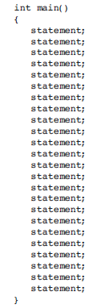
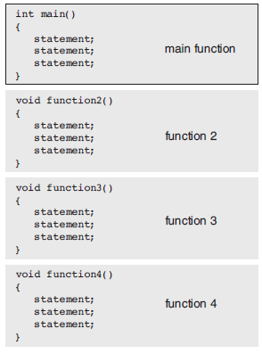
Program 1 : Functions in C++
Why Functions?
Functions are commonly used to break a program down into small manageable pieces.
Instead of writing all of the statements of the program in the main function, several small functions can partition the program to be simpler to understand. Each small function does a specific part of the program. These functions can then be called in the desired order.

Slide 15

Program 2 : Functions in C++
//Any C++ program must contain a main function.
//This program contains also another function named "sum".
#include <iostream>
using namespace std;
//Function definition
int sum(int a, int b) {
int s = a + b;
return s;
}
int main() {
int x = sum(4, 5);
cout << "x = " << x;
return 0;
}
Start
main()
Call function
sum(4,5)
(a =4,b=5)
Start
sum(a,b)
Here, main() function is waiting until sum() function ends
s = a + b
end
sum()
return s
x =s
Print x
end
main()

Slide 16
Program 2 : Functions in C++
//Function definition
int sum(int a, int b) {
int s = a + b;
return s;
}
Start
main()
Call function
sum(4,5)
(a =4,b=5)
Line 6 shows the header of the function sum(). This header shows three important parts of the function:
The name of this function is (sum).
The return type of this function which is (integer) int.
The parameter list (int a, int b) which contains two integer variables separated by a comma.
Lines 7 and 8 between { .. } represent the body of this function. Line 7 calculates the sum of the values of a and b variables, and set the sum to s. Line 8 ends the function returning the value of s.
This function is called in line 11 in the main function using the statement : (int x = sum(4, 5);)
This “function call” assigns a = 4, and assigns b = 5, then the body of the function starts and calculates s = a+b=4+5=9. Finally, the program returns 9 to the main function.
Start
sum(a,b)
Here, main() function is waiting until sum() function ends
s = a + b
end
sum()
return s
x =s
Print x
end
main()

Slide 17
Program 3 : Functions in C++
//Any C++ program must contain a main function.
//This program contains also another function named "sum".
#include <iostream>
using namespace std;
//Function prototype
int sum(int a, int b);
int main() {
int x = sum(4, 5);
cout << "x = " << x;
return 0;
}
//Function definition
int sum(int a, int b) {
int s = a + b;
return s;
}
Start
main()
Call function
sum(4,5)
(a =4,b=5)
Start
sum(a,b)
Here, main() function is waiting until sum() function ends
s = a + b
end
sum()
return s
x =s
Print x
end
main()

Slide 18
Program 3 : Functions in C++
//Function prototype
int sum(int, int);
Start
main()
Line 6 shows the prototype of the function sum(). This prototype shows three important parts of the function including the name, input and output data type.
The function prototype is the function header followed be semicolon.
Notice in the previous program (64), the function definition of sum() is placed before the main function that contains the function call of sum(). This is because that the compiler must read the definition of the function sum before calling it. The C++ compiler reads the program from the top in order to down. This is why the #include statements must be written in the top of the program, so that the C++ compiler must know first about the functions inside the libraries before using them in the program.
In order to avoid writing the function definition before the main function, the function prototype only can be placed before the main function and the whole function then can be placed after the main function.
Call function
sum(4,5)
(a =4,b=5)
Start
sum(a,b)
Here, main() function is waiting until sum() function ends
s = a + b
end
sum()
return s
x =s
Print x
end
main()

Slide 19

Program 4 : Functions in C++
#include <iostream>
#include <cmath>
using namespace std;
const double PI = 3.14;
//Function "cArea" prototype, circle Area.
float cArea(float);
//Function "main" definition.
int main() {
float radius;
cout << "Enter the radius of a circle : ";
cin >> radius;
cout << "The area of the circle is " << cArea(radius);
return 0;
}
//Function "cArea" definition.
float cArea(float r) {
float area = PI * pow(r, 2);
return area;
}
Start
main()
Get radius
Call function
cArea(radius)
(r=radius)
Start
cArea(r)
Here, main() function is waiting until cArea(radius) function ends
area =pi*r²
end
cArea()
return area
Print area
end
main()

Slide 20
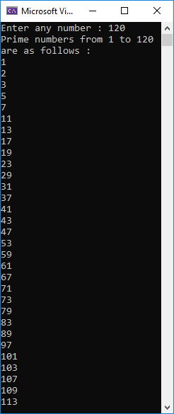
Program 5 : Functions in C++
//This program prints all the prime numbers;
//Starting from 1 and until a user input n;
#include<iostream>
using namespace std;
bool isPrime(int);
void main() {
int n;
cout << "Enter any number : "; cin >> n;
cout << "Prime numbers from 1 to " << n;
cout << " are as follows : " << endl;
for (int i = 1; i < n; i++) {
if (isPrime(i))
cout << i << endl;
}
}
bool isPrime(int x) {
bool prime = true;
for (int i = 2; i < x; i++) {
if (x % i == 0) {
prime = false;
break;
}
}
return prime;
}

Slide 21

Program 6 : Functions in C++
Start
main()
str = “main”
#include <iostream>
#include <string>
using namespace std;
string second(string str2) {
string str = str2 + "-" + "second";
return str;
}
string first(string str1) {
string str = str1 + "-" + "first";
str = second(str);
return str;
}
int main() {
string str = "main";
str = first(str);
cout << str;
return 0;
}
Call function
first(str)
(str1=str)
Here, main() function is waiting until first(str) function ends
Start
first(str1)
str=str1+”first”
Call function
second(str)
(str2=str)
Here, first() function is waiting until second(str) function ends
Start
second(str2)
str=str2+”second”
end
second()
return str
end
first()
Print str
return str
end
main()

Slide 22
Program 6 : Functions in C++
This program steps starts at line 13
#include <iostream>
#include <string>
using namespace std;
string second(string str2) {
string str = str2 + "-" + "second";
return str;
}
string first(string str1) {
string str = str1 + "-" + "first";
str = second(str);
return str;
}
int main() {
string str = "main";
str = first(str);
cout << str;
return 0;
}
The program starts in the main function.
Defines string str of value “main”
1. Function call to function first(str).
The input parameter in first(), str1=str
Defines string str of value = str1+“first”
2. Function call to function second(str).
The input parameter in first(), str2=str
Defines string str of value = str2+“second”
3. Return back to function call in line 10.
Assign the returned value to str in first().
4. Return back to function call in line 15.
Assign the returned value to str in main().
Print the string str.
End the main function
3. return
2. Function call
4. return
1. Function call

Slide 23
Program 6 : Functions in C++
This program has 3 sub-programs
#include <iostream>
#include <string>
using namespace std;
string second(string str2) {
string str = str2 + "-" + "second";
return str;
}
string first(string str1) {
string str = str1 + "-" + "first";
str = second(str);
return str;
}
int main() {
string str = "main";
str = first(str);
cout << str;
return 0;
}
This program contains 3 functions, each function is considered as a sub-program.
Functions main, first, and second.
Notice that the variable str is defined 3 times in this program, one in each function. This program has 3 different variables of the same name “str”, each variable has a different variable.
Programmer can not define 2 variables of the same name in the same function. However, the programmer can define the same variable in different functions in the same program.
Each function has a separate scope that contains variables. The value of the variables in each function is removed from the memory one the function ends and returns back to its caller.

Slide 24

Program 7 : Functions in C++
The variable x in the main() function has the value of 4.
The variable x in the change() function has the value of 4 then changed to 5.
// This program just shows the passing of a value
// of a specific variable to the called function.
// This program passes the value of x to the
// function change().
#include <iostream>
using namespace std;
void change(int x) {
x = 5;
}
int main() {
int x = 4;
change(x);
cout << "x = " << x; //Prints 4
return 0;
}
Start
main()
x = 4
Call function
change(x)
(x=x=4)
Start
change(x)
Here,main() function is waiting until dispMesg() function ends
x=5
end
change()
The variable x in the main() did not change its value.
Print x
end
main()

Slide 25
Program 7 : Functions in C++
The variable x in the main() function has the value of 4.
The variable x in the change() function has the value of 4 then changed to 5.
int x = 4;
change(x);
void change(int x) {
x = 5;
}
Start
main()
x = 4
The value of x which is 4 is assigned to another variable of the same named but in a different function (scope).
Here we say the value of x is passed from the main() function to the change function().
This is called “pass by value”
Function main() defined a variable named as “x” and set its value by 4, and function change() defined another variable named as “x” also. Although the two variables in the two function have the same name, these variables are completely different and saved in the memory in two different place.
When the value of x in the change() function is changed from 4 to 5, the value of x in the main() function is the same.
Call function
change(x)
(x=x=4)
Start
change(x)
Here,main() function is waiting until dispMesg() function ends
x=5
end
change()
Print x
The variable x in the main() did not change its value.
end
main()

Slide 26
Program 7 : Functions in C++
Memory
scope
main()
int main() {
int x = 4;
change(x);
..
}
void change(int x) {
x = 5;
}
x = 4
scope
change()
x = 5
Each function has its own scope of variables, this scope includes all the variables defined in this function. The value of these variables can be assigned within the function to change their values. Any change in the values of these variables must be done within the function’s scope.
Function change() does not have a returned value so a programmer can not return the value of its variable x.
So, to change the value of x from 4 to 5 in the main() function and not in the change() function only, the programmer should not pass the value of x, the programmer should use the “pass by address” as shown in the next program.

Slide 27

Program 8 : Functions in C++
A address of the variable x is passed from the main() function to the change() function.
// This program just shows the passing of a value
// of a specific variable to the called function.
// This program passes the address of x (&x) to the
// function change().
#include <iostream>
using namespace std;
void change(int &x) {
x = 5;
}
int main() {
int x = 4;
change(x);
cout << "x = " << x; //Prints 5
return 0;
}
Start
main()
x = 4
Call function
change(x)
(&x=x=4)
Start
change(&x)
Here,main() function is waiting until dispMesg() function ends
x=5
end
change()
The variable x in the main() has change its value from 4 to 5.
Print x
end
main()

Slide 28
Program 8 : Functions in C++
Memory
scope
main()
x = 4
int main() {
int x = 4;
change(x);
cout<<x;
}
void change(int &x) {
x = 5;
}
scope
change()
&x=x
Here the program passes the address of the variable x in the memory; This process is called “pass by address”
Any variable saved in the memory has a location in the memory, this location is named in programming as the address.
The address of any variable is abbreviated by the sign &. The reason of selecting the “and” sign that it starts by the letter a.
The variable x in the parameter list in line 7 is an address to an integer variable, and it is not an integer. The address x is the address of the integer variable x in the main function.
Any change in the value of the address x in the change() function will change the value of x in the main() function.
The change in line 8, x=5, in the change() function, will change of the value of x in the main() function and prints 5.
The memory after the change in line 8, x=5.
Memory
scope
main()
x = 5
scope
change()
&x=x
x=5

Slide 29
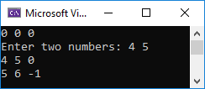
Program 9 : Functions in C++
func1
#include <iostream>
using namespace std;
void func1(int& a, int& b) {
cout << "Enter two numbers: ";
cin >> a >> b;
}
void func2(int &a, int &b, int &c) {
b++;
c--;
a = b + c;
}
int main(){
int x = 0, y = 0, z = 0;
cout << x << " " << y << " " << z << endl;
func1(x, y);
cout << x << " " << y << " " << z << endl;
func2(x, y, z);
cout << x << " " << y << " " << z << endl;
return 0;
}
&a = x
&b = y
func2
&a = x
&b = y
&c = z

Slide 30

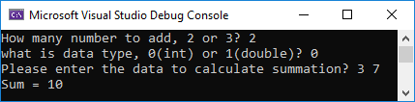
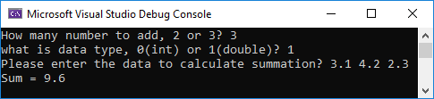
Program 10 : Functions
//This program shows the concept of overloading
#include <iostream>
using namespace std;
int sum(int a, int b) { return a + b; }
int sum(int a, int b, int c) { return a + b + c; }
double sum(double a, double b) { return a + b; }
double sum(double a, double b, double c) { return a + b + c; }
int main() {
int n; bool type;
int xi = 0, yi = 0, zi = 0;
double xd = 0, yd = 0, zd = 0;
cout << "How many numbers to add, 2 or 3? "; cin >> n;
cout << "what is data type, 0(int) or 1(double)? "; cin >> type;
cout << "Please enter the data to calculate summation? ";
if (n == 2 && type){
cin >> xd >> yd; cout << "Sum = " << sum(xd, yd);}
else if (n == 2 && !type){
cin >> xi >> yi; cout << "Sum = " << sum(xi, yi);}
else if (n == 3 && type){
cin >> xd >> yd >> zd; cout << "Sum = " << sum(xd, yd, zd);}
else if (n == 3 && !type){
cin >> xi >> yi >> zi; cout << "Sum = " << sum(xi, yi, zi);}
return 0;
}

Slide 31
Program 10 : Functions in C++
int sum(int a, int b) { return a + b; }
int sum(int a, int b, int c) { return a + b + c; }
double sum(double a, double b) { return a + b; }
double sum(double a, double b, double c) { return a + b + c; }
A function header represents the function name, input parameter list and output datatype. Note that C++ does not allow the program to include more than one function of the same header.
However, C++ allows the program to include more than one function of the same name only, using the overloading concept.
Overloading: having in the same program different functions of the same name to do the same operation, however these functions have different input parameter list and different data type of the output.
Lines 4, 5, 6, and 7 show 4 overloaded functions of the same name, but the number and the datatype in the input parameter lists are different and also the output datatype is different.
Lines 4 and 5 show 2 overloaded functions of the same name, the same output datatype, the same datatype of the input parameter list, however the number of input parameter list is different. The same for the functions for the lines 6 and 7.

Slide 32
Program 10 : Functions in C++
if (n == 2 && type){
cin >> xd >> yd; cout << "Sum = " << sum(xd, yd);}
else if (n == 2 && !type){
cin >> xi >> yi; cout << "Sum = " << sum(xi, yi);}
else if (n == 3 && type){
cin >> xd >> yd >> zd; cout << "Sum = " << sum(xd, yd, zd);}
else if (n == 3 && !type){
cin >> xi >> yi >> zi; cout << "Sum = " << sum(xi, yi, zi);}
According to the user input, the program selects the correct overloaded function to call.
The user can select the number of variables to add, and also the user can select the datatype of the variables to add.
The if-else statement in lines 15 to 22 calls one of the four overloaded functions of the same name “sum”. The following statements represents the function calls in the main program:
sum(xd, yd); //xd and yd are 2 double variables.
sum(xd, yd, zd); //xd, yd and zd are 3 double variables.
sum(xi, yi); //xi and yi are 2 integer variables.
sum(xi, yi, zi); //xi, yi and zi are 3 integer variables.

Slide 33

Program 11 : Functions in C++
// Program to compute absolute value
// Works for both int and float
#include <iostream>
using namespace std;
float absolute(float var) {// function with float type parameter
if (var < 0.0)
var = -var;
return var;
}
int absolute(int var) {// function with int type parameter
if (var < 0)
var = -var;
return var;
}
int main() {
// call function with int type parameter
cout << "Absolute value of -5 = " << absolute(-5) << endl;
// call function with float type parameter
cout << "Absolute value of 5.5 = " << absolute(5.5f) << endl;
return 0;
}

Slide 34


Program 12 : Functions in C++
// This program gets from the user 3 numbers, x, y, and z.
// Then prints (x^y^z), x to the power y to power z
// This program does not use the cmath library
#include <iostream>
using namespace std;
int pow2(int x, int y, int z) {
int result1 = 1;
for (int i = 0; i < y; i++) {
result1 = result1 * x;
}
int result2 = 1;
for (int i = 0; i < z; i++) {
result2 = result2 * result1;
}
return result2;
}
int main() {
int x, y, z;
cout << "Enter 3 numbers, x, y, and z:";
cin >> x >> y >> z;
cout << "x^y^z=" << pow2(x,y,z);
return 0;
}
$$a=x^{y^{z}}$$

Slide 35
Sample MCQ for Programming So far :
What is the output of the following Program?
#include<iostream>
using namespace std;
double functy(double d){
d = d + 1;
return d;
}
int main(){
double j = 0;
for (int i = 0; i < 3; i++);
j = functy(j);
cout << j;
return 0;
}
Compile time error in line 7
1
2
0
3
What is the output of the following Program?
#include<iostream>
using namespace std;
int f1(int x){ return x + x; }
int f2(int x){ return f1(x) + x; }
int f3(int x){ return f2(x) + f2(x); }
int main(){ cout << f3(2); return 0;}
16
18
8
12
10

Slide 36
Sample MCQ for Programming So far :
What is the output of the following Program?
#include<iostream>
using namespace std;
int funct1(int x, int &y){
int z = 6;
x += z;
y += z;
z = x + y;
return z;
}
int main(){
int a = 4, b = 5, g = 7;
if (a != b)
g = funct1(a, b);
cout<<"a="<<a<<", b="<<b<<", g="<<g<<".";
return 0;
}
a=4, b=5, g=7.
a=4, b=6, g=18.
a=4, b=11, g=21.
a=2, b=11, g=18.
a=2, b=5, g=18.
What is the output of the following Program?
#include <iostream>
using namespace std;
int data(int g) {
return g % 2;
}
int main() {
string dd = "aA";
int s = 0;
for (int i = 0; i < dd.length(); i++)
s += dd.at(i);
cout << data(s);
int 0;
}
0
1
Compile time error in line 11
Compile time error in line 4
Run time error in line 10

Slide 37
Sample MCQ for Programming So far :
What is the output of the following Program?
#include<iostream>
using namespace std;
int funct3(int& x) { return x++; }
int funct2(int x) { return funct3(x); }
int funct1(int x) { return funct2(x); }
void main() {
int x = 3;
cout << funct1(x) + funct2(x) + funct3(x) + x;
}
Compile time error
10
12
13
9
What is the output of the following Program?
#include <iostream>
using namespace std;
void test(int = 2, int = 4, int = 6);
int main()
{
test();
test(6);
test(3, 9);
test(1, 5, 7);
return 0;
}
void test(int first, int second, int third)
{
first += 3;
second += 6;
third += 9;
cout << first << " " << second;
cout << " " << third << endl;
}
5 10 15 b) 5 11 16 c) 9 10 16
9 10 15 9 11 15 6 10 15
6 15 15 5 10 15 6 11 15
4 11 16 4 11 15 5 10 14

Slide 38
Sample MCQ for Programming So far :
What is the output of the following Program?
#include <iostream>
using namespace std;
void fun1(int &y) { y++; }
void fun2(int& x) { x++; fun1(x); }
void fun3(int& z) { z++; fun2(z); }
void main() {
int x = 2;
fun1(x);
fun2(x);
fun3(x);
cout << x;
}
5
7
8
6
4
What is the output of the following Program?
#include <iostream>
#include <string>
using namespace std;
int fun1(int x, int y) { return x + y; }
int fun2(string s) { return s.length(); }
int fun3(bool a, char c) { return (int)a+(int)c; }
void main() {
cout<<fun1(1, 2)+fun2("Computing")+fun3(true, 'A');
}
98
88
78
68
58

Slide 39
Introduction to Programming and Problem Solving
Lecture 2
Files and File Streaming
Dr. Mostafa Salama

Slide 40
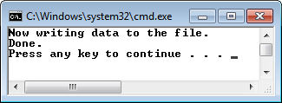
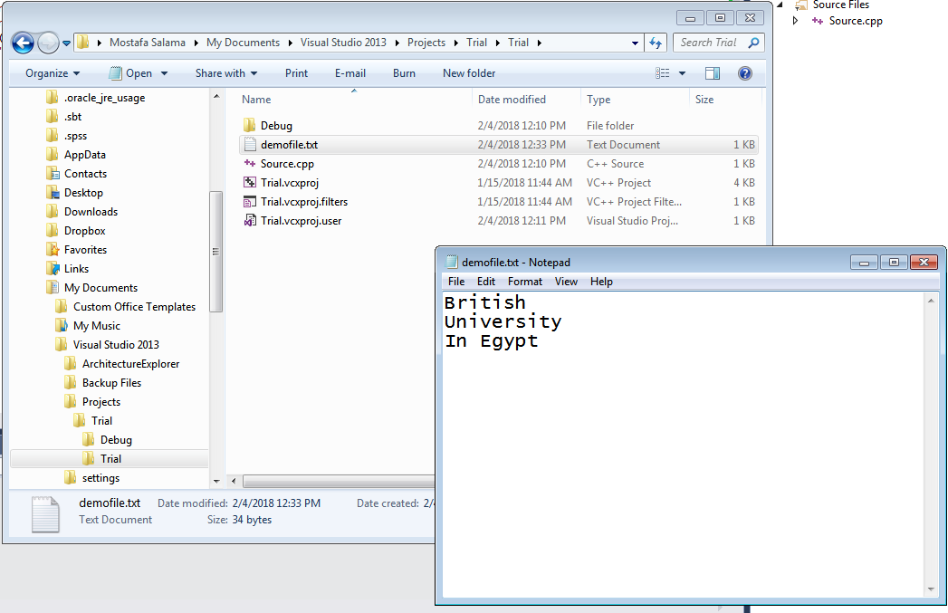
Program 13 : Files
// This program creates a file of name demofile.txt, and
// Write the text "British University in Egypt", and then
// Close the file.
#include <iostream>
#include <fstream>
using namespace std;
int main(){
ofstream outputFile;
outputFile.open("demofile.txt");
cout << "Now writing data to the file.\n";
outputFile << "British \n";
outputFile << "University \n";
outputFile << "In Egypt \n";
outputFile.close();
cout << "Done.\n";
return 0;
}

Slide 41
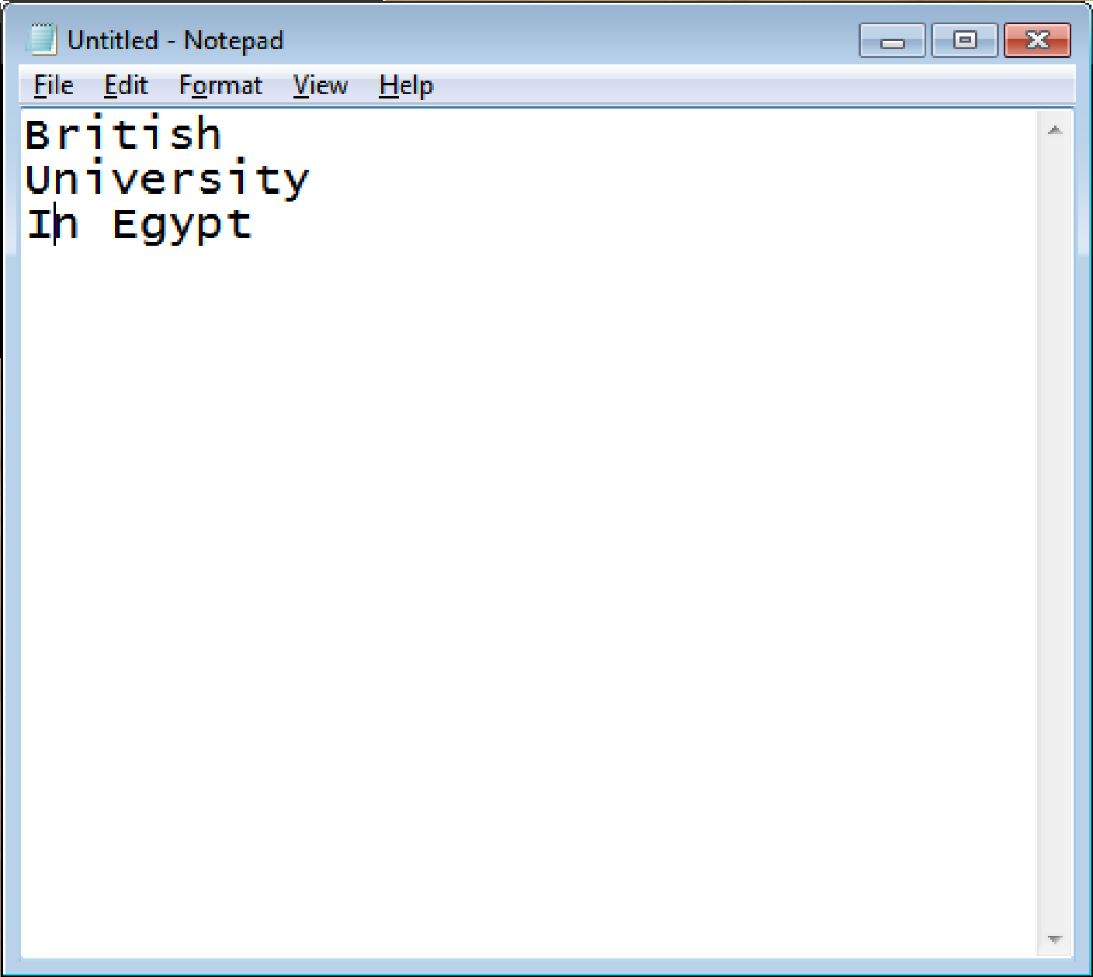
Program 13 : Files
#include <fstream>
A C++ program can create, edit and delete files within the file system of the computer. C++ provides a built-in library fstream to allow programs to access files. The library contains three classes ofstream, ifstream, and fstream.
To create a file for writing, define an object of type ofstream. The letters o in the term ofstream stands for output, and f for file, and stream refers to the data. This object allows the creation of a file for writing data, e.g. demofile.txt.
To access an existing file for reading, define an object of type ifstream. The letters i in the term ifstream stands for input. This object allows reading of the text in the file only without adding any text.
To access an existing file for reading and writing, define an object of type fstream. This object allows openning files for reading, writing, or both.

Slide 42
Program 13 : Files
ofstream outputFile;
outputFile.open("demofile.txt");
outputFile << "British \n";
Line 8 defines an object outputFile of type class ofstream. This object allows the creation of a file for writing.
Line 9 uses the object outputFile to open a file of name “demofile.txt”. If the file dose not exist, the object outputFile creates an empty file of this name. Line 9 creates the file on the same path of the C++ code project. To specify a different path of the file, the new path is added as follows: “c:\\data\\demofile.txt”.
outputFile.open("c:\\data\\demofile.txt");

Slide 43
Program 13 : Files
ofstream outputFile;
outputFile.open("demofile.txt");
outputFile << "British \n";
outputFile << "University \n";
outputFile << "In Egypt \n";
outputFile.close();
Lines 11, 12 and 13 use the object outputFile to write a text, e.g. “In Egypt \n”, in the file “demofile.txt”. The object outputFile uses the stream insertion operator (<<) to write text in the file. C++ uses the same syntax to write data in the command prompt and the file. The term “cout” is replaced by the object name outputFile to write on the file instead of the command prompt. Each string that was written to the file ends with a newline escape sequence (\n).
Line 14 uses the object outputFile to close the access to the file. Closing a file causes any unsaved data that may still be held in a buffer to be saved to its file. This frees unnecessary resources for better performance, like removing the buffered file contents that is allocated in the memory.

Slide 44
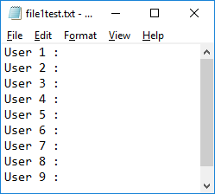
Program 14 : Writing to files
1
outputFile
#include <iostream>
#include <fstream>
using namespace std;
int main() {
//1-Define object outputFile for writing
ofstream outputFile;
//2-Use object outputFile to open a file
outputFile.open("file1test.txt");
//3-Writing in the file
for (int i = 1; i <= 9; i++) {
outputFile << "User "<< i << " : \n";
}
//4-Close the file
outputFile.close();
return 0;
}
2
4
3

Slide 45
Program 14 : Writing to files
ofstream outputFile; 1-Define
outputFile.open("file1test.txt"); 2-Open
outputFile << "User "<< i << " : \n"; 3-Write (access)
outputFile.close(); 4-Close
In general, accessing any file requires 4 main steps.
Step 1: Defining the object that is going to be used for accessing the file system.
Step 2: Opening a specific file for writing if it is existing in the file system, Otherwise it creates the file and opens it for writing.
Step 3: Lines 11 uses the object outputFile to write a text in the file “file1test.txt”. The object outputFile uses the stream insertion operator (<<) to write text in the file. C++ uses the same syntax to write data in the command prompt and the file. The term “cout” is replaced by the object name outputFile to write on the file instead of the command prompt. Each string that was written to the file ends with a newline escape sequence (\n).
Step 4: Line 14 uses the object outputFile to close the access to the file. Closing a file causes any unsaved data that may still be held in a buffer to be saved to its file. This frees unnecessary resources for better performance, like removing the buffered file contents that is allocated in the memory.

Slide 46
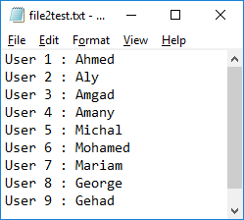
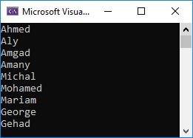
Program 15 : Reading from files
#include <iostream>
#include <string>
#include <fstream>
using namespace std;
int main() {
ifstream inputFile;//For reading
inputFile.open("file2test.txt");
for (int i = 1; i <= 9; i++) {
string temp, name;
//input1File >> temp; // do not work correct, because of the space
getline(inputFile, temp);
int nameStart = temp.find(':')+2;
int nameLength = temp.size() - nameStart;
name = temp.substr(nameStart, nameLength);
cout << name << endl;
}
inputFile.close();
return 0;
}

Slide 47
Program 15 : Reading from files
ifstream inputFile; 1-Define
inputFile.open("file2test.txt"); 2-Open
getline(inputFile, temp); 3-Read (access)
inputFile.close(); 4-Close
In general, accessing any file requires 4 main steps.
Step 1: Defining an object that is going to be used for accessing the file system.
Step 2: Opening a specific file for reading if it is existing in the file system.
Step 3: Lines 11 uses the object inputFile to read a text from the file “file2test.txt”.
C++ uses the same syntax to read data from the command prompt and the file. The term “cin” is replaced by the object name outputFile to write on the file instead of the command prompt. The object inputFile uses the stream insertion operator (>>) to read text in the file. Except that in this example, the statement {inputFile>>temp;} do not work correctly due to the existence of spaces in the text read from file. So it is replaced by the getline() function to solve this problem just like reading from the command prompt.
Step 4: Line 14 uses the object outputFile to close the access to the file. Closing a file causes any unsaved data that may still be held in a buffer to be saved to its file. This frees unnecessary resources for better performance, like removing the buffered file contents that is allocated in the memory.

Slide 48
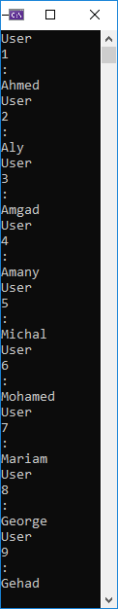

Program 16 : Reading
#include <iostream>
#include <fstream>
#include <string>
using namespace std;
int main(){
ifstream inputFile;
string text;
inputFile.open("file2test.txt"); //Open the file for reading.
if (inputFile){ //Check that the file opens correctly.
while (inputFile >> text){ //Check that end of file is not reached yet.
cout << text << endl;
}
inputFile.close();//close the file
}
else{
cout << "Error opening the file.\n";
}
cin >> text;
return 0;
}

Slide 49
Program 16 : Reading from files
inputFile.open("file2test.txt"); //Open the file for reading
if (inputFile){ //Check that file opens correctly
while (inputFile >> text){ //Check that end of file is not reached yet
cout << text << endl;
}
inputFile.close(); //close the file
}
This program tests if the file is opened for reading successfully. Then the program keeps reading terms from the file until its end.
Step 1: Defining an object of type ifstream for reading from a file.
Step 2: Opening the file existing in the file system for reading. In the case that this file does not exist, the if condition in line 9 is going to be false. An in the case that this file exists and opened successfully.
Step 3: Quite often a program must read the contents of a file without knowing the number of terms that are stored in the file. Lines 10 keeps getting a term from the file until no more terms are remained to get. A term is a word or a number without spaces, a “User” word, “1” is number term, and “:” is special character term. In the case that the statement of “inputFile >> text” get a term successfully from the file, then the statement has the value true. And in case that the file ends and no more term exists to be retrieved.
Step 4: When the loop for reading ends, line 13 closes the file to free the allocated resources for this file.

Slide 50
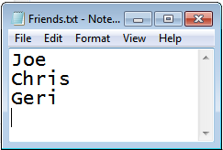
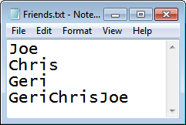
Program 17 : Reading & Writing
//This program opens a file for reading its contents.
//Then the prgram appends its content with a new one.
#include <iostream>
#include <fstream>
#include <string>
using namespace std;
void main() {
string FullNames = " ", name;
fstream rwFile;
rwFile.open("Friends.txt", ios::in);
while (rwFile >> name) {
FullNames = name + FullNames;
}
rwFile.close();
rwFile.open("Friends.txt", ios::app);
rwFile << FullNames;
rwFile.close();
}

Slide 51
Program 17 : Reading & Writing
fstream rwFile;
rwFile.open("Friends.txt", ios::in); //==> rwFile >> name
rwFile.close();
rwFile.open("Friends.txt", ios::app); //==> rwFile << FullNames
rwFile.close();
The datatype of object “rwFile” is the class fstream. This type of objects allows the program to do both, reading from a file and writing into a file.
Line 9 defines an object of type fstream for accessing (read/write) a file in the system.
Line 10 uses the fstream object to open a file for reading. The open() function in thie fstream object has two parameters, the first parameter is the file name, and the second parameter is the purpose of the opening the file. If the purpose of opening that file is reading, then the second parameter is ios::in. This fstream object use the operator (>>) to read text terms from the file, and uses the close() function to close the file.
Line 15 uses the same fstream object to open a file for writing. If the purpose of opening that file is adding text to the end of the file (appending), then the second parameter in the open function is ios::app. This fstream object use the operator (<<) to write text into the file, and uses the close() function to close the file.
Note that after reading the file, the object close the file and re-open it for the new purpose which is writing (app).

Slide 52
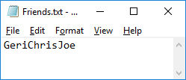
Program 17 : Reading & Writing
while (rwFile >> name) {
FullNames = name + FullNames;
}
Line 11 shows a while statement, the condition of continue looping is that the file still contains text to read. The condition between the while brackets() is a reading statement that is either successful in reading (true) or not (false).
If the reading statement {rwFile >> name} in line 11 reads a text successfully, then the file is not ended yet. In this case, the system considers that the result of reading is true and the while loop runs the statement in line 12.
If the reading statement in line 11 fails to read data, then this means that files ends and no more text to read. In this case, the system considers that the result of reading is false and the while loop terminates.
If the second parameter in the open function is ios::out, The file is opened for writing.
If the file does not exist, it is created.
If the file already exists, its contents are deleted (the file is truncated). The file is opened as empty file and the new text is added at the beginning of the file.
fstream rwFile;
rwFile.open("Friends.txt", ios::out);
rwFile.close();

Slide 53

Program 18 : Reading & Writing
#include <iostream>
#include <fstream>
#include <string>
using namespace std;
int main(){
string filename = "TestRW.txt", buffer;
fstream outputfile, inputfile;
outputfile.open(filename, ios::out); if (outputfile.fail()) return 0;
outputfile << "British University in Egypt"; outputfile.close();
inputfile.open(filename, ios::in); if (inputfile.fail()) return 0;
//Start from the very begining
inputfile.seekg(0, ios::beg); inputfile >> buffer; cout << buffer << endl;
//Start from the begining by 3 places
inputfile.seekg(3, ios::beg); inputfile >> buffer; cout << buffer << endl;
//Start from the end back 5 character.
inputfile.seekg(-5, ios::end); inputfile >> buffer; cout << buffer << endl;
inputfile.close();
return 0;
}

Slide 54
Program 18 : Reading & Writing
string filename = "D:\\Trial.txt", buffer;
fstream outputfile, inputfile;
outputfile.open(filename, ios::out); if (outputfile.fail()) return 0;
outputfile << "British University in Egypt"; outputfile.close();
inputfile.open(filename, ios::in); if (inputfile.fail()) return 0;
Lines 6 and 7 defines 4 objects, line 6 defines two string objects and line 7 define two fstream objects. Both fstream objects will access the same file, but one for writing (out) and one for reading (in).
The object “outputfile” is for writing (out). The second statement in line 8 is a conditional statement that tests if the condition (outputfile.fail()) is true or false. The fail() function in the fstream objects returns true if the file fails to create or open, the reason of failure could be due to the permission/security of the computer system or the storage is full.
In general, the return statement ends the program. Here the program terminates if the outputfile object fails to open the file.
Line 9 writes in the file the statement “British University in Egypt” and then closes the file.
Line 10 uses the fstream object to open a file for reading (in). It tests if the inputfile object fails to open file. If it fails to open, then the program terminates. the file fails to open due to reasons like the file does not exist or no permissions to open the file,

Slide 55
Program 18 : Reading & Writing
inputfile.seekg(0, ios::beg); inputfile >> buffer; cout << buffer << endl;
inputfile.seekg(3, ios::beg); inputfile >> buffer; cout << buffer << endl;
inputfile.seekg(-5, ios::end); cout << buffer << endl;
In general, reading from a file starts from the beginning of the file, and continues to the end of the file. The position of the reading pointer from a newly opened file is zero, and program read a text the reading pointer moves to the position of next text to read.
seekg() sets the position of the next character to be extracted from the file input stream. The word seek mean to search or to look out for getting something. And the character g refers to the getting action. If the program requires to read from a specific position, it moves the reading pointer to this position. The inputfile object of type fstream has the function “seekg”, this function moves reading pointer to any position within the file.
The function seekg(position, offset) has two parameters. The position refers to the location where the program should start reading, while the offset refers to the place of start counting the location from. For example, line 12 starts reading from the beginning and count 0 characters, while line 14 starts from the beginning and then place the reading pointers after three characters.

Slide 56
Program 18 : Reading & Writing
inputfile.seekg(0, ios::beg); inputfile >> buffer; cout << buffer << endl;
inputfile.seekg(3, ios::beg); inputfile >> buffer; cout << buffer << endl;
inputfile.seekg(-5, ios::end); cout << buffer << endl;
Line 12 places the reading pointer at position 0 from the beginning, then reads a string from the file. Since the reading operator () ends after space, so it reads the word “British” only.
Line 14 places the reading pointer at position 3 from the beginning, then reads a string from the file. It starts reading after third character in the word “British”, so starts at character t and ends at h before the space as “tish”.
Line 16 places the reading pointer at 5 places (characters) before the end of the file. It moves backward by 5 characters before the end of the file.

Slide 57
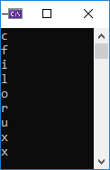
Program 19 : Reading & Writing
#include <iostream>
#include <fstream>
#include <string>
using namespace std;
int main() {
fstream accessFile;
accessFile.open("Trial.txt", ios::out);
accessFile << "abcdefghijklmnopqrstuvwxyz" << endl;
accessFile.close();
accessFile.open("Trial.txt", ios::in);
char c;
while (!accessFile.eof()) {
accessFile.seekg(2, ios::cur);
accessFile >> c;
cout << c << endl;
}
accessFile.close();
return 0;
}

Slide 58
Program 19 : Reading & Writing
accessFile << "abcdefghijklmnopqrstuvwxyz" << endl;
accessFile.open("Trial.txt", ios::in);
while (!accessFile.eof()) {
accessFile.seekg(2, ios::cur);
accessFile >> c;
cout << c << endl;
}
Lines 8 uses the object “accessFile” to write in the text file "Trial.txt" the alphabet from ‘a’ to ‘z’, then this object closes the file.
Line 10 uses the object “accessFile” to read from the text file "Trial.txt". Line 12 shows a looping statement that continue iterating if the object “accessFile” did not reach the end of the opened file “eof”.
Notice that when the file is opened for reading, the reading pointer starts at the first position of index zero.
In line 13, the object “accessFile” uses the seekg() function to move the reading pointer from the current position “ios::cur” by two character. Then line 14 reads the character at the position where the reading pointer is pointing to, then line 15 prints this character.
Lines 13, 14, and 15 are repeated until the end of file “eof” is reached.
Notice that when object “accessFile” read the character ‘x’, the reading pointer points to the character ‘y’. And when the reading pointer moves by two character by the “seekg()” function, the pointer reaches the end of the file and nothing to read. In this case, line 14 fails to read any character, and so the value of c remains of the same value x.

Slide 59
Sample Problem: to be solved by the student for training.
Write a C++ program that receives from the user 10 integers.
This program creates two files, one for odd number “oddFile.txt”, and one for even numbers “evenFile.txt”
For every entered integer by the user, the program checks this number:
If this number is even, then it is added to the “evenFile.txt”,
Otherwise this number is added to the “oddFile.txt”.
Then write a function that calculates the averages of the values in a file. Then call this function twice, once for the “evenFile.txt” file and once for the “oddFile.txt” file. Then print the two average values.
59

Slide 60
Sample MCQ for Programming So far :
What is the output of the following Program?
#include <iostream>
#include <fstream>
#include <string>
using namespace std;
void main(){
fstream dataFile;
string name;
dataFile.open("demofile.txt", ios::out);
dataFile << "string1" << "\n";
dataFile.close();
dataFile.open("demofile.txt", ios::out);
dataFile << "string2" << "\n";
dataFile.close();
dataFile.open("demofile.txt", ios::in);
if (dataFile.eof()) cout << "END";
else{ dataFile >> name;cout << name; }
dataFile.close();
}
String2
“Run time error in line 8”
“Run time error in line 14”
String1String2
String1
What is the output of the following Program? If the Test2.txt file contains online one line : "British University in Egypt [ICS]"
#include <iostream>
#include <fstream>
#include <string>
using namespace std;
void main() {
string filename = "Test2.txt", buffer;
fstream inputfile;
inputfile.open(filename, ios::in);
inputfile.seekg(8, ios::beg);
inputfile.seekg(-2, ios::cur);
inputfile >> buffer; cout << buffer << endl;
inputfile.close();
}
itish
h
Uni
“Nothing is printed”
“Run time error”

Slide 61
Introduction to Programming and Problem Solving
Lecture 3
1dim-Arrays
Dr. Mostafa Salama

Slide 62
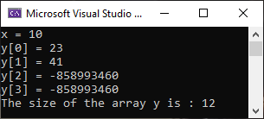
Program 20 : 1-Dim Array
RAM
Size=4*3
23
0
y
41
1
-858993460
2
#include <iostream>
using namespace std;
int main() {
int x = 10;
//Defining an array of integers of size 3
int y[3];
y[0] = 23;
y[1] = 41;
//If x is not initialized or assigned, a compile time error
cout << "x = " << x << endl;
cout << "y[0] = " << y[0] << endl; //Prints 23
cout << "y[1] = " << y[1] << endl; //Prints 41
cout << "y[2] = " << y[2] << endl; //Prints rubbish
//Warning: Index '3' is out of valid index range '0' to '2'
cout << "y[3] = " << y[3] << endl;
cout << "The size of the array y is : " << sizeof(y) << endl;
return 0;
}
Size=4
x
10

Slide 63
Program 20 : 1-Dim Array
RAM
Size=4*3
23
0
y
41
1
-858993460
2
int x = 10;
int y[3];
y[0] = 23;
y[1] = 41;
Size=4
x
10
Lines 4 defines a primitive datatype, which is the integer variable x. Any variable of a primitive datatype is designed to hold a single value. The size of this variable in memory is 4 bytes. The variable x is also initialized to the value ‘10’.
Line 6 defines a complex datatype as an array of integer variables. An array is a complex datatype that can hold multiple values of the same datatype. The name of the array y follows the datatype int of the elements in the array, and the number inside the box brackets [] represents the size of the array, it indicates the number of values that the array can hold. Finally then, line 6 defines an array of name y that can hold 3 integers values.
The size of the array y is three, such that this array can hold 3 integer values. The entire array has only one name, and each element in the array is accessed by a unique index. The statement “y[0] = 23;” in line 7 saves the value 23 in the array y in the first element of index 0.
The index of the elements in the array starts by the index 0 to first element, followed by second element of index 1, and the third element is of index 2. Accordingly, if the size of the array is three, then the index of the last element is 2.

Slide 64
Program 20 : 1-Dim Array
RAM
Size=4*3
23
0
y
41
1
-858993460
2
cout << "x = " << x << endl;
cout << "y[0] = " << y[0] << endl;
cout << "y[1] = " << y[1] << endl; //Prints 41
cout << "y[2] = " << y[2] << endl;
cout << "y[3] = " << y[3] << endl;
cout << "The size of the array y is : " << sizeof(y) << endl;
Size=4
x
10
Any variable of a primitive type must be initialized or assigned to a value before being used or printed. If the value of the variable is used before being initialized, the visual studio compiler will show an error in the compile time.
Unlike variables, if the value of one element in the array is not initialized, the program will run without a compile-time error or a run-time error, but the value of this non-initialized element is rubbish. The rubbish value printed on the output screen is “-858993460”.
The range of indexes of the array is based on its size, if the size of the array is 3 then the range of values starts from 0 to 3-1. If the index used in accessing values in the array is not in the correct range, then the value of this index is rubbish. The index is said to be not in the correct range if it is of a negative value or its value is greater than the size of the array -1.
Line 17 uses the sizeof() function to print the size of the array y. The array y holds three integers and the size of an integer is 4 bytes, then the memory allocated for this array y is of size 4x3 which is 12 bytes.

Slide 65
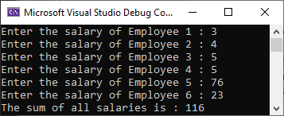
Program 21 : Looping in Array
#include <iostream>
using namespace std;
int main() {
const int nEmp = 6;
int eSal[nEmp], sum=0;
for (int i = 0; i < nEmp; i++) {
cout << "Enter the salary of Employee ";
cout << i + 1 << " : ";
cin >> eSal[i];
}
for (int i = 0; i < nEmp; i++) {
sum += eSal[i];
}
cout << "The sum of all salaries is : " << sum;
return 0;
}

Slide 66
Program 21 : Looping in Array
const int nEmp = 6;
int eSal[nEmp], sum=0;
for (int i = 0; i < nEmp; i++) {
cout << "Enter the salary of Employee ";
cout << i + 1 << " : ";
cin >> eSal[i];
}
Lines 4 defines a constant integer nEmp of a value 6. Then line 5 uses this constant integer to set the size of the array of integers eSal.
When defining an array, the number of values in the array must be either a value or a constant integer. It can not be a variable because the size of the array should be predefined and can not be changed during the running of the program.
If line 4 defines nEmp as a variable, the compiler shows an error “expression must have a constant value” in line 5.
The for loop in line 5 iterates on all the elements of the array, starting by the element at index zero (0), and ending by the element at index (nEmp-1). The number of iterations of this for loop is 6 iterations. At each iteration, the statements in lines 7, 8 and 9 get a value from the user and set this value to the iterated element in the array.
The for loop in line 11 iterates on all the elements. At each iteration, the statement in line 12 gets a value from the iterated element in the array and add it to the sum value.

Slide 67

Program 22 : Array Size Constant
#include <iostream>
using namespace std;
int main() {
const int s = 10;
int age[s] = {13, 10, 20, 21, 31, 25, 14};
//print array in correct order
for (int i = 0; i < s; i++) {
cout << age[i] << ", ";
}
cout << endl;
//print array in reverse order
for (int i = s-1; i >= 0; i--) {
cout << age[i] << ", ";
}
return 0;
}

Slide 68
Program 22 : Array Size Constant
const int s = 10;
int age[s] = {13, 10, 20, 21, 31, 25, 14};
Lines 5 defines a constant integer 6 of a value 10. Then line 6 uses this constant integer to set the size of the array of integers age.
Line 6 defines and initializes the array age. The initialization list in line 6 is a series of values separated by commas and between curly brackets. These values are stored in the array elements in the order they appear in the list.
The array in line 6 reserve in the memory 10 places, and so C++ expects to be initialized by 10 elements. Three cases are expected here:
If the list includes exactly 10 elements, then the 10 elements are places in the 10 places of the array.
If the list includes less number of elements as the statement of line 6 that includes 7 elements only, then C++ completes the list in the array by zero values.
{13, 10, 20, 21, 31, 25, 14, 0, 0, 0}
If the list includes more number of elements, a compile time error appears “too many initializer values”.
The array can be defined and initialized without setting its size, C++ will reserve a number of places in the memory exactly according the number of values in the list.
int age[] = {13, 10, 20, 21, 31, 25, 14};

Slide 69
Program 22 : Array Size Constant
for (int i = 0; i < s; i++) cout << age[i] << ", ";
for (int i = s-1; i >= 0; i--) cout << age[i] << ", ";
Lines 7 iterates through elements of the array, starting from the first of index 0 to the last element of index 9. As shown in the output, the array includes the 7 values used in the initialization list, while the rest of the elements in the array are initialized by zero.
{13, 10, 20, 21, 31, 25, 14, 0, 0, 0}
Lines 12 iterates through elements of the array in a reverse order, starting from the last of element in the array of index 9 (s-1) to the first element of index 0. As shown in the output:
{0, 0, 0, 14, 25, 31, 21, 20, 10, 13}
It is important to remember that in C++, the values of the elements in the array are initialized to zero if the array is not initialized.

Slide 70


Program 23 : Function call
#include <iostream>
using namespace std;
int find(int arr[], int size, int query) {
for (int i = 0; i < size; i++) {
if (arr[i] == query)
return i;
}
return -1;
}
int main(){
int q;
const int s = 10;
int age[s] = { 10, 12, 14, 17, 11, 2, 4, 5, 12, 11};
cout << "What is the number you are looking for ? ";
cin >> q;
int result = find(age, s, q);
if (result != -1)
cout << "The number you entered is of index " << result;
else
cout << "The number you entered is not found ";
return 0;
}

Slide 71
Program 23 : Function call
const int s = 10;
int age[s] = { 10, 12, 14, 17, 11, 2, 4, 5, 12, 11};
int result = find(age, s, q);
int find(int arr[], int size, int query) {
}
The main function passes the array age, the constant s, and the variable q to the function find(,,). The value of size is equals to the value of s in the main() function, and the value of query is equals to the value of q in the main() function.
The first parameter in the function find(int arr[], int size, int query) is the array arr[]. Notice that the array parameter arr[] does not include the size of the array between the box brackets.
After calling the function in line 16, the array age[] in the function main() is passed by reference to the array arr[] in the function find(,,).
Pass by reference means that both array names age[] and arr[] are referring to the same array. And inside the body of function find(,,), the array arr[] is referring to the elements in the array age[].
Int find(arr[], …) {
}
int main(){
age[s] = { 10, 12, …
find(age, …
}
arr[]
10
12
14
age[]

Slide 72
Program 23 : Function call
int find(int arr[], int size, int query) {
for (int i = 0; i < size; i++) {
if (arr[i] == query)
return i;
}
return -1;
}
The main function passes the array age, the constant s, and the variable q in the function call find(age, s, q). The role of this function is to find a specific value q in the array age of size s.
The for loop in line 4 iterates for (size = s) times across the elements in the array (arr[i] = age). And at each iteration, the condition in line 5 tests if element arr[i] in this iteration is equal to the value of query.
So it tests if (arr[0]==query), (arr[1]==query), (arr[2]==query) … and (arr[size-1]==query).
However, if one of these tests succeeded, then the required number (query) is found and no need to continue searching. So, the function terminates the loop by returning the index of the found element.
The statement (return i;) in line 6 terminates the function and returns the index of the required element. And the statement return -1; in line 8 terminates the function and returns the value of -1 which means the q or query is not found in the array age or arr.

Slide 73

Program 24 : Array of characters
#include <iostream>
using namespace std;
bool compare(char arr1[], char arr2[], int size) {
bool equal = true;
for (int i = 0; i < size; i++) {
if (arr1[i] != arr2[i])
equal = false;
}
return equal;
}
int main() {
char strArray1[] = { 'E','g','y', 'p', 't' };
char strArray2[] = "Egypt";
bool result = compare(strArray1, strArray2, 5);
if (result)
cout << "The two arrays are identical";
else
cout << "The two arrays are not identical";
return 0;
}
strArray1
E | g | y | p | t
strArray2
E | g | y | p | t

Slide 74
Program 24 : Array of characters
char strArray1[] = { 'E','g','y', 'p', 't' };
char strArray2[] = "Egypt";
bool result = compare(strArray1, strArray2, 5);
bool compare(char arr1[], char arr2[], int size) { .. }
Lines 12 and 13 define two arrays of characters strArray1 and strArray1. Both arrays are of the same number of elements, and also the elements in both arrays are identical. However, both arrays are initialized by two different ways.
The first array is initialized using the curly bracket to enclose a set of characters that are separated by a comma. Note that the number of elements in both arrays is not stated in the box brackets, this is because C++ can indicate the number of the elements of an array by counting the initialized number of elements between the curly brackets {}.
The second array is initialized as a string between double Quotations "Egypt", as the string is known as a series of character. C++ considers the first character in the string "Egypt" as a the first character in the array strArray2[0]='E', and the second character in the string "Egypt" is the second character in the array strArray2[1]='g', and so on.
Both arrays are passed as parameters to function compare() as arr1[], arr2[]. This function compares between each pair of corresponding characters in both arrays. If all pairs of corresponding characters do no follow this condition (arr1[i] != arr2[i]), then these two arrays are identical and the function returns true. If this condition is true for any pairs of corresponding characters, then this function returns false.

Slide 75
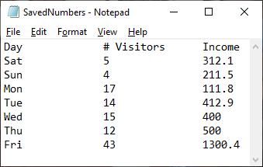
Program 25 : Save to File
#include <iostream>
#include <fstream>
#include <string>
using namespace std;
void saveToFile(string arr1[], int arr2[], double arr3[], int sizeOfArrays) {
ofstream outputFile;
outputFile.open("SavedNumbers.txt");
outputFile << "Day" << "\t\t" << "# Visitors" << "\t" << "Income" << "\n";
for (int count = 0; count < sizeOfArrays; count++) {
outputFile << arr1[count] << "\t\t";
outputFile << arr2[count] << "\t\t";
outputFile << arr3[count] << "\n";
}
outputFile.close();
}
int main() {
const int size = 7;
int numVisitors[size] = { 5, 4, 17, 14, 15, 12, 43 };
double income[size] = { 312.1, 211.5, 111.8, 412.9, 400, 500, 1300.4 };
string days[size] = {"Sat", "Sun", "Mon", "Tue", "Wed", "Thu", "Fri" };
saveToFile(days, numVisitors, income, size);
return 0;
}

Slide 76
Program 25 : Save to File
int numVisitors[size] = { 5, 4, 17, 14, 15, 12, 43 };
double income[size] = { 312.1, 211.5, 111.8, 412.9, 400, 500, 1300.4 };
string days[size] = {"Sat", "Sun", "Mon", "Tue", "Wed", "Thu", "Fri" };
saveToFile(days, numVisitors, income, size);
Line 18 defines an array of integer named as numVisitors, the number of elements in this array is size=7.
Then line 19 defines an array of doubles as income. Both numVisitors and income are arrays of primitive data type variables.
Then line 20 defines an array of strings named as days. Each element in this array is an object of a complex data type of class string.
A string object contains two parts, the first part is an array of characters and the second part includes the functions that are used for this array like find(), substr(), and at(). For example, the string “Sat” is considered as an array of characters [‘S’, ‘a’, ‘t’]. A function in the class string like find loops on the array to search for a specific character.
Accordingly, the array days is array of strings, and each element is considered as an array of characters. This means that the array days is considered as an array of arrays.
Line 21 passes the three arrays “days”, “numVisitors”, “income”, and “size” to the function saveToFile(string[], int[], double[], int). The role of this function is to print the contents of this array in a file "SavedNumbers.txt".

Slide 77
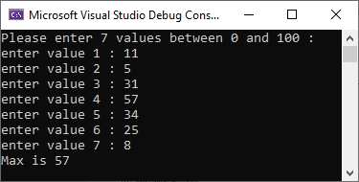
Program 26 : 1-Dim Array
#include <iostream>
using namespace std;
void getValues(int arr[], int size) {
for (int i = 0; i < size; i++) {
cout << "enter value " << i + 1 << " : ";
cin >> arr[i];
}
}
int maxValue(int arr[], int size) {
int max = -1;
for (int i = 0; i < size; i++) {
if (max < arr[i]) max = arr[i];
}
return max;
}
void main() {
const int size = 7;
int data[size];
cout << "Please enter 7 values between 0 and 100 : \n";
getValues(data, size);
int maxVal = maxValue(data, size);
cout << "Max is " << maxVal << " \n ";
}

Slide 78
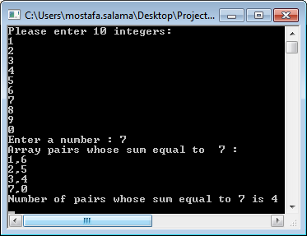
Program 27: 1-Dim Array
#include <iostream>
using namespace std;
const int arrSize = 10;
void getData(int array[], int sizeOfArray){
cout << "Please enter " << sizeOfArray << " integers: \n";
for (int i = 0; i < sizeOfArray; i++)
cin >> array[i];
}
}
void main(){
int array[arrSize];
getData(array, arrSize);
int sumPair = 0;
cout << "Enter a number : "; cin >> sumPair;
cout << "Array pairs whose sum equal to " << sumPair << " :\n";
int counter = 0;
for (int i = 0; i < arrSize; i++)
for (int j = i + 1; j < arrSize; j++)
if (array[i] + array[j] == sumPair){
cout << array[i] << "," << array[j] << endl;
counter++;
}
cout << "Number of pairs whose sum equal to " << sumPair;
cout << " is " << counter << "\n";
}

Slide 79
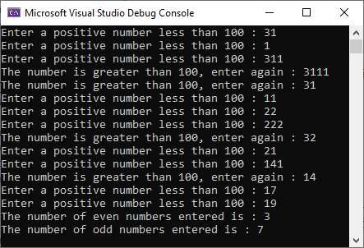
Program 28 : 1-Dim Array
#include <iostream>
using namespace std;
int main(){
const int s = 10;
int userInput, i = 0;
int age[s];
while (i < s) {
cout << "Enter a positive number less than 100 : ";
do {
cin >> userInput;
if (userInput > 100)
cout << "The number is greater than 100, enter again : ";
} while (userInput > 100);
age[i++] = userInput;
}
int counterOdd = 0, counterEven = 0;
for (int i = 0; i < s; i++) {
if (age[i] % 2 == 0) counterEven++;
else counterOdd++;
}
cout << "The number of even numbers entered is : " << counterEven << "\n";
cout << "The number of odd numbers entered is : " << counterOdd << "\n";
return 0;
}

Slide 80

Program 29 : Sorting
#include <iostream>
using namespace std;
void sortArr(int arr[], int s) {
for (int i = 0; i < s; i++) {
for (int j = i + 1; j < s; j++) {
if (arr[i] > arr[j]) {
int temp = arr[i];
arr[i] = arr[j];
arr[j] = temp;
}
}
}
}
int main() {
const int s = 10;
int age[s] = {13, 10, 20, 21, 31, 25, 14};
sortArr(age, s);
//print the array in a sorted order
for (int i = 0; i < s; i++) {
cout << age[i] << ", ";
}
return 0;
}

Slide 81
Program 29 : Sorting
const int s = 10;
int age[s] = {13, 10, 20, 21, 31, 25, 14};
sortArr(age, s);
void sortArr(int arr[], int s) {
}
Lines 15 defines an a constant integer s of a value 10. Then line 16 uses this constant integer to set the size of the array of integers age, and initializes the array by 10 elements.
Then line 17 is a function call statement sortArr(age, s). This function call will hold the processing of the main function and start processing the code in the function sortArr(). After finishing the code in the function, the code in the function resumes processing in line 19.
The main function passes the array age and the variable s to the function sortArr(,). The array is passed by reference without using the address operator &. Pass by reference means that any change in the array elements or the order of these elements in the array, the change will be applied in the original array in the main function. The array is always passed by reference using its name only without the address operator.
The function sortArr(int arr[], int s) starts working after being called in line 17. This function does not return any data, as the return data type is void which means that it has no return statement.
The role of this function is to change the order of the elements within the passed array. These elements are not sorted and the role of this function is to sort these elements in an ascending order. The original array will be changed after running the code in this function.

Slide 82
Program 29 : Sorting
for (int i = 0; i < s; i++) {
for (int j = i + 1; j < s; j++) {
if (arr[i] > arr[j]) {
int temp = arr[i];
arr[i] = arr[j];
arr[j] = temp;
}
}
}
i
j
0
1
2
3
4
5
6
7
8
9
13 | 10 | 20 | 21 | 31 | 25 | 14 | 0 | 0 | 0
arr[]
2
Swap
13>10
Swap
temp
1
3
13
i
j
0
1
2
3
4
5
6
7
8
9
arr[]
10 | 13 | 20 | 21 | 31 | 25 | 14 | 0 | 0 | 0
The code includes two nested loops in lines 4 and 5, and keep comparing each pair of elements in the array in line 6. Lines 7, 8 and 9 swap elements to place the smaller element before the largest elements in the array.
In the first iteration in the outer-loop, the first element of index i=0 is 13 and is compared, by the second element of index j=1, if it is greater, then the two elements are swapped. Then the first element of index i=0 is compared to the third element of index j=2, if it is greater, then swapping and so on until the last element is reached in the array by the index j.
(10 is not > 20)
i
No Swap
j
0
1
2
3
4
5
6
7
8
9
arr[]
10 | 13 | 20 | 21 | 31 | 25 | 14 | 0 | 0 | 0
(10 is not > 21)
No Swap
………
i
j
0
1
2
3
4
5
6
7
8
9
10 | 13 | 20 | 21 | 31 | 25 | 14 | 0 | 0 | 0
arr[]
2
(10 > 0)
1
Swap
3
temp
10
i
………
j
0
1
2
3
4
5
6
7
8
9
0 | 13 | 20 | 21 | 31 | 25 | 14 | 10 | 0 | 0
arr[]
2
(0 is not > 0)
No Swapping

Slide 83
Program 29 : Sorting
for (int i = 0; i < s; i++) {
for (int j = i + 1; j < s; j++) {
if (arr[i] > arr[j]) {
int temp = arr[i];
arr[i] = arr[j];
arr[j] = temp;
}
}
}
i
j
0
1
2
3
4
5
6
7
8
9
arr[]
0 | 13 | 20 | 21 | 31 | 25 | 14 | 0 | 0 | 0
Swap
(13 is not > 21)
No Swapping
j
i
………
0
1
2
3
4
5
6
7
8
9
2
arr[]
0 | 13 | 20 | 21 | 31 | 25 | 14 | 0 | 0 | 0
In the second iteration in the outer-loop, the second element of index i=1 is 13 and is compared, by the third element of index j=2, if it is greater, then the two elements are swapped. Then the second element is compared to the fourth element of index j=3, if it is greater, then swapping and so on until the last element is reached in the array by the index j.
This process continues until all the elements in the array are sorted in an ascending order.
(13 > 0)
Swap
3
temp
1
13
i
………
j
0
1
2
3
4
5
6
7
8
9
arr[]
0 | 0 | 20 | 21 | 31 | 25 | 14 | 13 | 0 | 0
(0 is not > 0)
No Swapping
i
j
9
0
1
2
3
4
5
6
7
8
arr[]
0 | 0 | 20 | 21 | 31 | 25 | 14 | 13 | 0 | 0
(20 is not > 21)
No Swapping

Slide 84
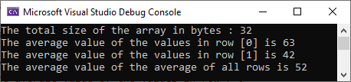
Program 30 : 2-Dim Array
#include <iostream>
using namespace std;
int main() {
const int rows = 2, cols = 4;
int grades[rows][cols] = { {73, 35, 63, 81}, {63, 56, 31, 21} };
cout << "The total size of the array in bytes : ";
cout << sizeof(grades) << endl;
int avgPerRow, avgTotal = 0;
for (int i = 0; i < rows; i++) {
avgPerRow = 0;
for (int j = 0; j < cols; j++) {
avgPerRow = avgPerRow + grades[i][j];
}
avgPerRow /= cols;
cout << "The average value of the values in row [";
cout << i << "] is " << avgPerRow << endl;
avgTotal += avgPerRow;
}
avgTotal /= rows;
cout << " The average value of the average of all rows";
cout << " is " << avgTotal << endl;
return 0;
}
grades[2][4]
First col
Sec col
Third col
Four col
First row
[0][0] | [0][1] | [0][2] | [0][3]
[1][0] | [1][1] | [1][2] | [1][3]
Second row
grades[rows][cols]
73 | 35 | 63 | 81
63 | 56 | 31 | 21
Notes:
int grades1[4]; //definition a 1 dim array of 4 integers. Index of first integer is 0
grades1[0] = 41;
grades1[1] = 12;
grades1[2] = 232;
grades1[3] = 47;
int grades2[4]; //definition a 1 dim array of 4 integers. Index of first integer is 0
grades2[0] = 41;
grades2[1] = 12;
grades2[2] = 232;
grades2[3] = 47;

Slide 85
Introduction to Programming and Problem Solving
Lecture 4
2dim-Arrays
Dr. Mostafa Salama

Slide 86
Program 30 : 2-Dim Array
const int rows = 2, cols = 4;
int grades[rows][cols] = { {73, 35, 63, 81}, {63, 56, 31, 21} };
cout << "The total size of the array in bytes : ";
cout << sizeof(grades) << endl;
Lines 4 defines two constant integers rows of value 2 and cols of value 4.
Line 5 defines an array grades[][] of two dimensions. A one dimensional array includes only one row or series of elements, while a two dimensional array includes more than one row of elements. A two dimensional array many include two rows like the above example, and it may include more rows like 3, 4, 5, and as much as possible.
The first box bracket in the two dimensional array represents the number of rows in the array, the and second box bracket represents the number of cols in the array.
Line 7 print out the size of the grades[][] array. This array contains 2*4=8 integers, and the size of each integer is 4 bytes. Then the size this array is printed as 32, which means 32 byte.
Line 4 can be initialized in this way which is acceptable and provides the same meaning.
grades[2][4]
First col
Sec col
Third col
Four col
First row
[0][0] | [0][1] | [0][2] | [0][3]
[1][0] | [1][1] | [1][2] | [1][3]
Second row
grades[rows][cols]
73 | 35 | 63 | 81
63 | 56 | 31 | 21
int grades[rows][cols] = { 73, 35, 63, 81, 63, 56, 31, 21 };

Slide 87
Program 30 : 2-Array
for (int i = 0; i < rows; i++) {
int avgPerRow = 0;
for (int j = 0; j < cols; j++) {
avgPerRow = avgPerRow + grades[i][j];
}
avgPerRow /= cols;
grades[2][4]
One for loop statements is required to go through the elements within a one-dimensional array. Two nested for loops are required to go through all the elements within a two-dimensional array.
The outer for-loop in line 9 iterates through rows in the grades[rows][cols]. Each row in this array contains a number of columns.
The inner for-loop in line 11 iterates through the elements (columns) in each row in the array grades[rows][cols].
Line 12 retrieve the values of each element in first row in the array grades to calculate the average value. This is done in the first iteration in the outer-loop. Then the same is done for all values in the second row within the second iteration in the outer-loop.
First col
Sec col
Third col
Four col
First row
[0][0] | [0][1] | [0][2] | [0][3]
[1][0] | [1][1] | [1][2] | [1][3]
Second row
grades[rows][cols]
73 | 35 | 63 | 81
63 | 56 | 31 | 21
for ( int i = 0; i <2; i ++){
for ( int j = 0; j < 4; j++){
avg += grades[i][j];
}
}

Slide 88
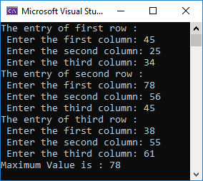
Program 31 : Pass 2-Dim Array
#include <iostream>
using namespace std;
const int Cols = 3; //Global constant
int getMax(int arr[][Cols], int R) {
int max = 0;
for (int i = 0; i < R; i++) {
for (int j = 0; j < Cols; j++)
if (max < arr[i][j]) max = arr[i][j];
}
return max;
}
int main() {
const int Rows = 3; //Local constant
int array[Rows][Cols];
string number[Rows] = { "first", "second", "third" };
for (int i = 0; i < Rows; i++) {
cout << "The entry of " << number[i] << " row :" << endl;
for (int j = 0; j < Cols; j++) {
cout << " Enter the " <<number[j]<< " column: ";
cin >> array[i][j];
}
}
cout << "Maximum Value is : " << getMax(array, 2);
}

Slide 89
Program 31 : Pass 2-Dim Array
const int Cols = 3; //Global constant
const int Rows = 3; //Local constant
int array[Rows][Cols];
string number[Rows] = { "first", "second", "third" };
Line 3 defines a global constant integer Cols of a value 3. This constant integer is defined as global because it is defined outside any function. This constant can be accessed from any function, either main() or getMax() functions.
Line 13 defines a local constant integer Rows of a value 3. This constant is defined as local because it is defined within the main() function. This constant can be accessed from the main() function only that is defined within.
Line 14 defined an array of two dimensions, the first dimension of size [Rows] and the second dimension of size [Cols].
Line 15 defines an array of strings of size [Rows]. This array is used for text representation of the rows in the two-dimensional array.
The first row in the array is of index 0
The first row in the array is of index 1
The first row in the array is of index 2

Slide 90
Program 31 : Pass 2-Dim Array
cout << "Maximum Value is : " << getMax(array, 2);
int getMax(int arr[][C], int R) {
int max = 0;
for (int i = 0; i < R; i++) {
for (int j = 0; j < C; j++)
if (max < arr[i][j]) max = arr[i][j];
}
return max;
}
Line 23 calls the function getMax(array, 2) and passes to this function the two-dimensional array array, and an integer R that represents the number of rows in this array.
Line 4 defines the function header “int getMax(int arr[][C], int R)”. The first parameter of this function is array “int arr[][C]”.
The first box bracket that represents the size of the rows of the array arr is empty. It is unknown to the function and should be passed separately through the second parameter “int R” of the function.
The second box bracket that represents the size of columns of the array arr is the global constant C. In C++, the two-dimensional array parameter in a function definition must include the size of columns.
The two nested loops in lines 6 and 7 go through all the elements in the array arr. These two nested loops search for the maximum value among a group of positive value, such that the minimum value must be zero. The initial value of the maximum max is zero as defined in line 5.

Slide 91

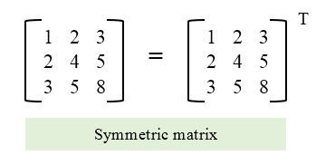

Program 32 : Pass 2-Dim Array
// symmetric or not.
#include <iostream>
using namespace std;
const int cols = 3;
// Returns true if mat[N][N] is symmetric,
// else false
bool isSymmetric(int mat[][cols], int N) {
for (int i = 0; i < N; i++)
for (int j = 0; j < N; j++)
if (mat[i][j] != mat[j][i])
return false;
return true;
}
int main() {
int mat[][cols] = { { 1, 3, 5 },{ 3, 2, 4 }, { 5, 4, 1 } };
cout << "{ { 1, 3, 5 },{ 3, 2, 4 }, { 5, 4, 1 } }\n";
if (isSymmetric(mat, 3))
cout << "This matrix is symmetric.";
else
cout << "This matrix is not symmetric.";
return 0;
}
$$\left[\begin{matrix}1 & 3 & 5 \\ 3 & 2 & 4 \\ 5 & 4 & 1\end{matrix}\right]$$

Slide 92
Sample Problem: to be solved by the students for training.
Write a C++ program to get from the user the results of 10 students, then saves the results in a file:
Define in the “main()“ function two-dimensional array of name “results” of 2 columns and 10 rows, the first column in this array is for physics module and the second column is for math. [2 marks]
In the “main()“ function, get from the user the values of the “results” array. Then call the function passed(results) to and print the returned value from this function. Then ask the user to enter a specific string variable “name” and call the function saveResults(results, name). [2 marks]
Pass the results array to a function passed(results), this function includes one parameter which is the results array. This function counts the number of students who passed in the two modules, if the two values are greater than 40. his function has an integer return type, it returns the counted number of passed students. [3 marks]
Pass the results array to a function saveResults(results, name), this function includes two parameter, the results array and a string name. This function saves values in the results array in a text file, the name of this file is the string name. This function has no return type. [3 marks]

Slide 93
Sample Problem: to be solved by the students for training.
Write a C++ program the get from a teacher the grades of a group of students to do some operations as follows:
In the main() function, get from the teacher the grades of 10 students for 5 subjects. Then save these grades in a two-dimensional array grades.
Pass the array grades to a function avgStudentGrade(), this function includes a parameter that represents the index of a students (from 0 to 9). This function will calculate and return the average grade of the five subjects for the passed index.
Call the function avgStudentGrade() from the main() function to print the average grade of every student.
Pass the array grades to a function avgSubjectGrade(), this function includes a parameter that represents the index of a subject (from 0 to 4). This function will calculate and return the average grade of the ten students for the passed index.
Call the function avgSubjectGrade() from the main() function to print the average grade of every subect.

Slide 94
Sample MCQ for Programming So far :
What is the output of the following program?
#include <iostream>
#include <string>
#include <fstream>
using namespace std;
string probFile = "example.txt";
const int numOfStr = 6;
void main() {
string ArrOrder[numOfStr];
ofstream yofile(probFile);
yofile << "none,\tfirst,\tsecond,\t";
yofile << "third,\tfourth,\tfifth";
ifstream myfile(probFile);
for (int i = 0; i < numOfStr; i++)
myfile >> ArrOrder[i];
myfile.close();
//Printing the output
for (int i = 0; i < numOfStr; i++)
cout << ArrOrder[i];
}
none, first, second, third, fourth, fifth
none,first,second,third,fourth,fifth
nothing is printed
none,\tfirst,\tsecond,\tthird,\tfourth,\tfifth
Error in line 10
What is the output of the following Program?
#include <iostream>
using namespace std;
int y = 2;
int proc2(int d) { return (d + y++); }
int proc1(int d) { return (d + ++y + proc2(d)); }
void main() {
int g = 1;
cout << proc1(g) + proc2(g);
string name[4] = { "Egyptian", "British",
"Arabian", "American" };
cout << "-" << name[2][2];
}
13-a
10-a
11-E
12-a
14-a

Slide 95
Sample MCQ for Programming So far :
What is the output of the following program?
#include <iostream>
using namespace std;
const int a = 3, b = 3;
int calc(int arr[][b]) {
int temp = 0;
for (int i = 0; i < a; i++)
for (int j = 0; j < b; j++)
temp += arr[0][j];
return temp;
}
void main() {
int array[a][b] = { {1, 2, 3}, {2, 3, 4} };
cout << calc(array) << endl;
}
12
18
15
“Compile time Error in line 4”
“Compile time Error in line 12”
What is the output of the following Program?
#include <iostream>
using namespace std;
const int a = 7;
void calc(int arr[], int g, int t) {
t = arr[g];
arr[g] = arr[g + 1];
arr[g + 1] = t;
}
void main() {
int array[a] = { 3, 4, 7, 1, 9, 1, 6 };
calc(array, 3, 2);
calc(array, 5, 4);
for (int i = (a - 1); i >= 0; i--)
cout << array[i] << " ";
cout << endl;
}
6 1 9 1 7 4 3
6 1 9 7 1 3 4
3 4 7 9 1 6 1
3 4 7 1 9 1 6
1 6 1 9 7 4 3

Slide 96
Sample MCQ for Programming So far :
What is the output of the following program?
#include <iostream>
using namespace std;
void main() {
string s = "Faster";
char as[] = "Safer";
int i = 1;
if (as[i] == s.at(i)){
cout << as[i++] << "," << as[++i]
cout << " at " << i << endl;
}
else
cout << "nothing";
}
f,e at 3
nothing
s,t at 2
“Compile time error in line 7”, can-not compare a string to an array.
f,e at 2
What is the output of the following Program?
#include<iostream>
using namespace std;
void main() {
const int n = 3, y = 3;
int r = 0;
int arr[n][y] = { {9, 4, 2}, { 1, 9, 8}, { 3, 3, 3} };
for (int i = n - 1; i >= 1; i--)
for (int j = y - 1; j >= 0; j--) {
r += arr[i][j] % n;
}
cout << r;
}
8
3
Error in line 6, array size miss-matching
[Nothing is Printed]
Run time error

Slide 97
Sample MCQ for Programming So far :
What is the output of the following program?
#include<iostream>
using namespace std;
int rec(int arr[][4], int s1) {
if (s1 == 0)
return arr[s1][s1 % 3] + 2;
else
arr[s1 % 3][s1] += 3;
rec(arr, s1 - 1);
}
void main() {
int data[5][4] = { { 1, 2, 3, 4 },
{ 2, 3, 9, 8 },
{ 1, 5, 15, 10 },
{ 7, 7, 7, 7 } };
cout << rec(data, 2);
}
5
2
3
Error in the function call in line 11
Error in the array definition in line 10
What is the output of the following Program?
#include<iostream>
using namespace std;
void main() {
int arr[] = { 2, 2, 1 };
string name = "alye";
cout << sizeof(arr) + sizeof(name.at(0)) + *arr;
}
5
15
14
13
2

Slide 98
Sample MCQ for Programming So far :
What is the output of the following program?
#include<iostream>
using namespace std;
void main(){
bool r[5] = { true, false, true };
for(int i = 0; i < 5; i++)
cout << r[i];
}
truefalsetrue
101
10100
Truefalsetruefalsefalse
01011
What is the output of the following Program?
#include <iostream>
using namespace std;
void main() {
int arr[4] = { 1, 2, 3, 4 };
cout << (sizeof(int) * 2);
cout << ", " << (sizeof(arr));
}
16, 8
8, 16
8, 8
16, 16
8, 4

Slide 99
Introduction to Programming and Problem Solving
Lecture 5
Pointers
Dr. Mostafa Salama

Slide 100
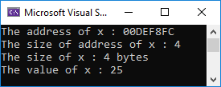
Program 33 : Pointers
#include <iostream>
using namespace std;
void main() {
int x = 25;
cout << "The address of x : " << &x << endl;
cout << "The size of address of x : " << sizeof(&x) << endl;
cout << "The size of x : " << sizeof(x) << " bytes\n";
cout << "The value of x : " << x << endl;
}
RAM
Size=4
Address of x is 00DEF8FC
&x = 00DEF8FC
x
25

Slide 101
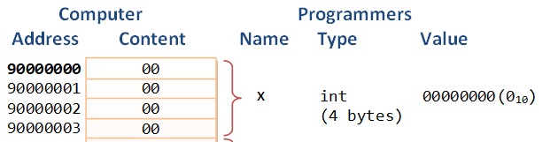
Program 33 : Pointers
RAM
Size=4
x
25
&x
int x = 25;
cout << "The address of x : " << &x << endl;
cout << "The size of address of x : " << sizeof(&x) << endl;
cout << "The size of x : " << sizeof(x) << " bytes\n";
cout << "The value of x : " << x << endl;
Every variable in C++ has a datatype, a name, a value, and an address. An address of a variable is the location of the variable in the computer’s memory. The address of a variable can be obtained by preceding the name of a variable with an ampersand sign (&), known as address-of operator. Address refers to the location of a variable in the memory.
The memory of computer is called “RAM” which is an abbreviation for “Random Access Memory”. When a variable is defined in the program, the computer placed the variable randomly in any location in the memory.
Every byte in the computer memory has an address. Variables are composed of multiple bytes, e.g. Integer x is saved in 4 bytes. The address of a variable is the address of the first byte in the variable.
The size of the address of a variable or an object is 4 bytes.

Slide 102
Program 33 : Pointers
int x = 25;
cout << "The address of x : " << &x << endl;
cout << "The size of address of x : " << sizeof(&x) << endl;
cout << "The size of x : " << sizeof(x) << " bytes\n";
cout << "The value of x : " << x << endl;
By default, C++ prints addresses in hexadecimal (base 16) to save space. Hexadecimal uses the numeric digits 0 through 9 and the letters 'a' through 'f' to represent the numeric values 0 through 15). So, instead of representing a decimal number 15 by two digits 1 and 5, this number can be represented in Hexadecimal by one digit only.
Line 4 defines a variable, the datatype of this variable is integer (int), the name of this variable is x, the value of this variable is 24, and finally the address of this variable which is (&x).
Line 5 pints the address of the variable x, that has the form (&x). The printed address has a hexadecimal representation. The number of digits in a hexadecimal number is much less than in a decimal number. The address (&x) is printed as 00DEF8FC. The printed address may be changed in every time the program runs. This is because the computer placed the variable in a random location every time.
Lines 6 prints the size of the address of the variable x, which is 4. This means that the address of any variable or object is 4 bytes.
While line 7 prints the size of the integer variable x. Finally, line 8 prints the value of the variable x which is 24.

Slide 103
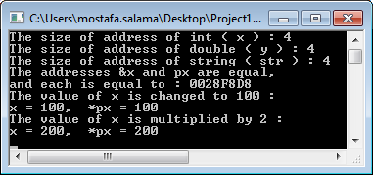
Program 34 : Pointers
#include <iostream>
#include <string>
using namespace std;
void main() {
int x = 25;double y = 31; string str = "British";
int *px; // Variable px is a pointer to an integer.
px = &x; // Store the address of the variable x in px.
double *py; // Variable py is a pointer to a double.
py = &y; // Store the address of the variable y in py.
string *pstr; // Variable pstr is a pointer to a string.
py = &y; // Store the address of the variable str in pstr.
cout << "The size of address of int ( x ) : " << sizeof(px) << endl;
cout << "The size of address of double ( y ) : " << sizeof(py) << endl;
cout << "The size of address of string ( str ) : " << sizeof(pstr) << endl;
if (px == &x){
cout << "The addresses &x and px are equal, " << endl;
cout << "and each is equal to : " << px << endl;
}
*px = 100; //Access the value of x indirectly.
cout << "The value of x is changed to 100 : \n";
cout << "x = " << x << ", *px = " << *px << endl;
*px *= 2; //Multiply the value of x by 2.
cout << "The value of x is multiplied by 2 : \n";
cout << "x = " << x << ", *px = " << *px << endl;
}

Slide 104
Program 34 : Pointers
int x = 25; double y = 31; string str = "British";
int *px; // Variable px is a pointer to an integer.
px = &x; // Store the address of the variable x in px.
double *py; // Variable py is a pointer to a double.
py = &y; // Store the address of the variable y in py.
string *pstr; // Variable pstr is a pointer to a string.
pstr = &str; // Store the address of the variable str in pstr.
The address of a variable or an object is a Hexadecimal number, the value of this number can be saved in another variable of type pointer. A pointer variable is defined by setting the symbol “*” before the variable name, for example {*px}. The pointer is a variable that holds the address of another variable of a specific data type, according to the pointer definition. For example, {int *px}, px is a pointer to a variable of data type {int}..
Line 5 defines an integer x, a double y, and a string str. Line 6 defines a pointer px, which is a variable that holds the address of an integer variable. Line 7 assigns the address of the variable x to the pointer px.
Lines 8 and 10 defines a pointer py to a double variable and a pointer pstr to a string object, respectively. Line 9 assigns the address of the double y to py, and line 10 assigns the address of the int x to px.
RAM
Size=4
px
0028F8D8
&px
Size=4
x
25
&x=0028F8D8

Slide 105
Program 34 : Pointers
cout << "The size of address of int ( x ) : " << sizeof(px) << endl;
cout << "The size of address of double ( y ) : " << sizeof(py) << endl;
cout << "The size of address of string ( str ) : " << sizeof(pstr) << endl;
if (px == &x){
cout << "The addresses &x and px are equal, " << endl;
cout << "and each is equal to : " << px << endl;
}
The pointer is a variable that holds a value, this value refers to an address in the memory. The size of this variable in the memory is four bytes, independent on the data type of the referred address. The size of pointers to integer, double or string is the same, 4 bytes.
Line 12 prints the size of the pointer px to an integer x, the printed value is 4. Line 13 prints the size of the pointer py, which is 4 also. Line 14 prints the size of the pointer pstr, which is 4 also.
if (px == &x){
The symbol px refers to a pointer variable that holds the address of the integer x.
The symbol &x refers to the address of the integer x.
Then, both symbols are the same and their values is equal, and the condition is true.
The value of px is printed as a hexadecimal number of 4 digit-pairs “0028F8D8”.

Slide 106
Program 34 : Pointers
*px = 100; //Access the value of x indirectly.
cout << "The value of x is changed to 100 : \n";
cout << "x = " << x << ", *px = " << *px << endl;
*px *= 2; //Multiply the value of x by 2.
cout << "The value of x is multiplied by 2 : \n";
cout << "x = " << x << ", *px = " << *px << endl;
The value of the variable can be accessed directly by the variable name {for example: cout<<x;}. Also, the value of the variable can be also accessed indirectly through the pointer to this variable {for example: cout<<*px;}. The symbol {*} precedes the pointer name to refer to the value of the variable pointed to by the pointer.
Line 10 sets the value of {*px} by 100. The variable {px} is a pointer to the integer variable x, it holds the value of the address of the integer variable x. The variable {*px} holds the value of the integer variable x itself.
So, the statement {*px = 100;} is the same as the statement {x = 100;}. In other words, the value of *px is the same as the value of x.
Line 10 contains the statement {*px *= 2;} that multiplies the value of *px by 2 and sets the result to again in *px. This statement can be completely replaced by the statement {x *= 2;} to do the same processing.
RAM
Size=4
px
0028F8D8
Size=4
(x) or (*px)
25
&x
It can described as follows : *px = *(&x) = *&x = x

Slide 107
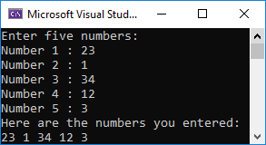
Program 35 : Pointers
#include <iostream>
using namespace std;
void main() {
//Define an array of integers
int numbers[5];
cout << "Enter five numbers: \n";
for (int count = 0; count < 5; count++) {
cout << "Number " << (count + 1) << " : ";
//Uses the name of array as a pointer to the array. The name of
//the array (numbers) saves the address of the first element.
cin >> *(numbers + count);
}
cout << "Here are the numbers you entered:\n";
for (int count = 0; count < 5; count++)
cout << *(numbers + count) << " ";
cout << endl;
}

Slide 108
Program 35 : Pointers
//Define an array of integers
int numbers[5];
//Uses the name of array as a pointer to the array. The name of
//the array (numbers) saves the address of the first element.
cin >> *(numbers + count);
The name of an array is considered as a pointer to the first element in this array. The name of the array is a variable of type pointer to the datatype of the array, this variable contains the address of the first element in the array.
Line 5 defines an array of five integers, the name of this array is numbers. C++ considers that numbers is a pointer to the first element in the array, which is numbers[0].
This means that numbers is variable of datatype {pointer to integer} and saves the address of the first integer in the array, which is the address of the first byte in this integer.
And this means also that the 5 successive integers in the memory that represents the array are anonymous, without name!!!.
Notice in the figure that the 5 integers are successive, as the addresses of the integers in the array are increasing by 4, which represents the size of the integer.
RAM
Size=4
numbers
0028F800
23
0028F800
5 successive integers that represents an array
1
0028F804
34
0028F808
12
0028F80C
3
0028F810

Slide 109
Program 35 : Pointers
//Define an array of integers
int numbers[5];
//Uses the name of array as a pointer to the array. The name of
//the array (numbers) saves the address of the first element.
cin >> *(numbers + count);
The name of an array is considered as a pointer to the first element in this array. The name of the array is a variable of type pointer to the datatype of the array, this variable contains the address of the first element in the array.
RAM
Line 11 uses the name of the array numbers as a pointer to an int variable, and uses the symbol *numbers to access the value of this variable. Notice that *numbers is the same as *(numbers).
The value *(numbers) represents the value of the first integer in the array. Remember that (numbers) contains the address of the first element (integer) in the array.
The value *(numbers+1) represents the value of the second integer in the array, as (numbers+1) represents the address of the second integer in the array.
Notice that (numbers) = 0028F800, while (numbers+1) = 0028F804. The incrementing here varies by 4 according to the size of the element, which is integer.
Size=4
numbers
0028F800
23
0028F800
5 successive integers that represents an array
1
0028F804
34
0028F808
12
0028F80C
3
0028F810

Slide 110
Sample MCQ for Programming So far :
What is the output of the following program?
#include <iostream>
using namespace std;
void main() {
//Define an array of integers
int numbers[3];
*numbers = 2;
*(numbers + 1) = 5;
*(numbers + 2) = 8;
cout << *numbers + 1 << " <-> ";
cout << *(numbers + 1) << endl;
cout << endl;
}
2 <-> 5
2 <-> 8
5 <-> 8
3 <-> 5
5 <-> 2
What is the output of the following Program?
#include<iostream>
using namespace std;
void main() {
int r = 0;
int arr[] = { 1, 2, 3, 4, 5, 6, 7, 8, 9 };
for (int i = 0; i < 9; i++)
r += ((*arr)++) % 4;
cout << r;
}
0
4
13
Error in line 7, Wrong Expression
[Nothing is Printed]

Slide 111
Sample MCQ for Programming So far :
What is the output of the following program?
#include <iostream>
using namespace std;
class circle {
private:
const int pi = 3;
int radius = 1;
double area;
void setRadius(int r) { radius = r; }
public:
circle() { }
circle(int r) { setRadius(r); }
int getArea() {
area = radius * radius * pi; return area;
};
};
void main() {
circle s2(2);
circle s1;
std::cout << s1.getArea() + s2.getArea();
}
Wrong output
Error in line 14
Error in line 15
3
15
What is the output of the following program?
#include <iostream>
using namespace std;
void main() {
int d[4] = { 2, 3, 4 };
int x = 3;
int* y = &x;
cout << (*(d + 1) + *y + *(d + 3)) << endl;
}
“Compile time error in line 7”, the d is an array.
6
3
7
9

Slide 112
Sample MCQ for Programming So far :
What is the output of the following program?
#include <iostream>;
using namespace std;
struct d {
int u;
d* v;
};
void main() {
d r[2]; (*r).u = 1; (*r).v = &(r[1]);
++(*r).u = 3; (*((*r).v)).u = 2;
int z = 0;
for (int i = 0; i < 2; i++)
z += r[i].u;
cout << z;
}
4
5
3
Compile time error
Run time error
What is the output of the following Program?
#include <iostream>
using namespace std;
class dataClass {
private:
float f = 1.1;
public:
float g = f + 1.3;
};
void main() {
dataClass* Arr;
int size = 3;
Arr = new dataClass[size];
Arr[0].g = 2;
cout << Arr->g + Arr[2].g;
}
“Compile time error in line 7”, f is private member variable.
“Compile time error in line 12”, size of array must be constant.
“Compile time error in line 10”, Arr->g is not a correct operator.
2.0
4.4
1.3

Slide 113
Sample MCQ for Programming So far :
What is the output of the following program?
#include <iostream>
using namespace std;
int x1 = 2;
int change(int x2, int& x3) {
return x1 + x2 + ++x3;
}
void main() {
int x4[4] = { 1, 2, 3, 0 };
int x5 = 2; x1 = 1;
int x6 = change(*x4, x5);
cout << x6 + x5 << endl;
}
6
“Compile time error in line 10”, function parameters are not correct.
8
3
5
What is the output of the following Program?
#include <iostream>
using namespace std;
void main() {
int a[3] = { 2, 3, 4 };
int v = 1, * r = &v, * p;
p = r;
*p += sizeof(a) / sizeof(int) + *(a + 1);
cout << v << '#' << *r;
}
7#3
4#9
2#8
5#5
7#7

Slide 114
Sample MCQ for Programming So far :
What is the output of the following Program?
#include <iostream>
using namespace std;
void main() {
int d[4] = { 1, 2, 3 };
char z = 65;
int* y = &d[2];
cout << z << "-";
cout << z + 1 << "-";
cout << *(d + 1) << "-";
cout << *y << "-";
cout << *(d + 3) << "-";
}
65-66-1-3-Null-
65-66-2-3-0-
A-B-2-3-0-
Compile time error
A-66-2-3-0-

Slide 115
Introduction to Programming and Problem Solving
End of Programming,
part 2
Dr. Mostafa Salama

